Slide 1
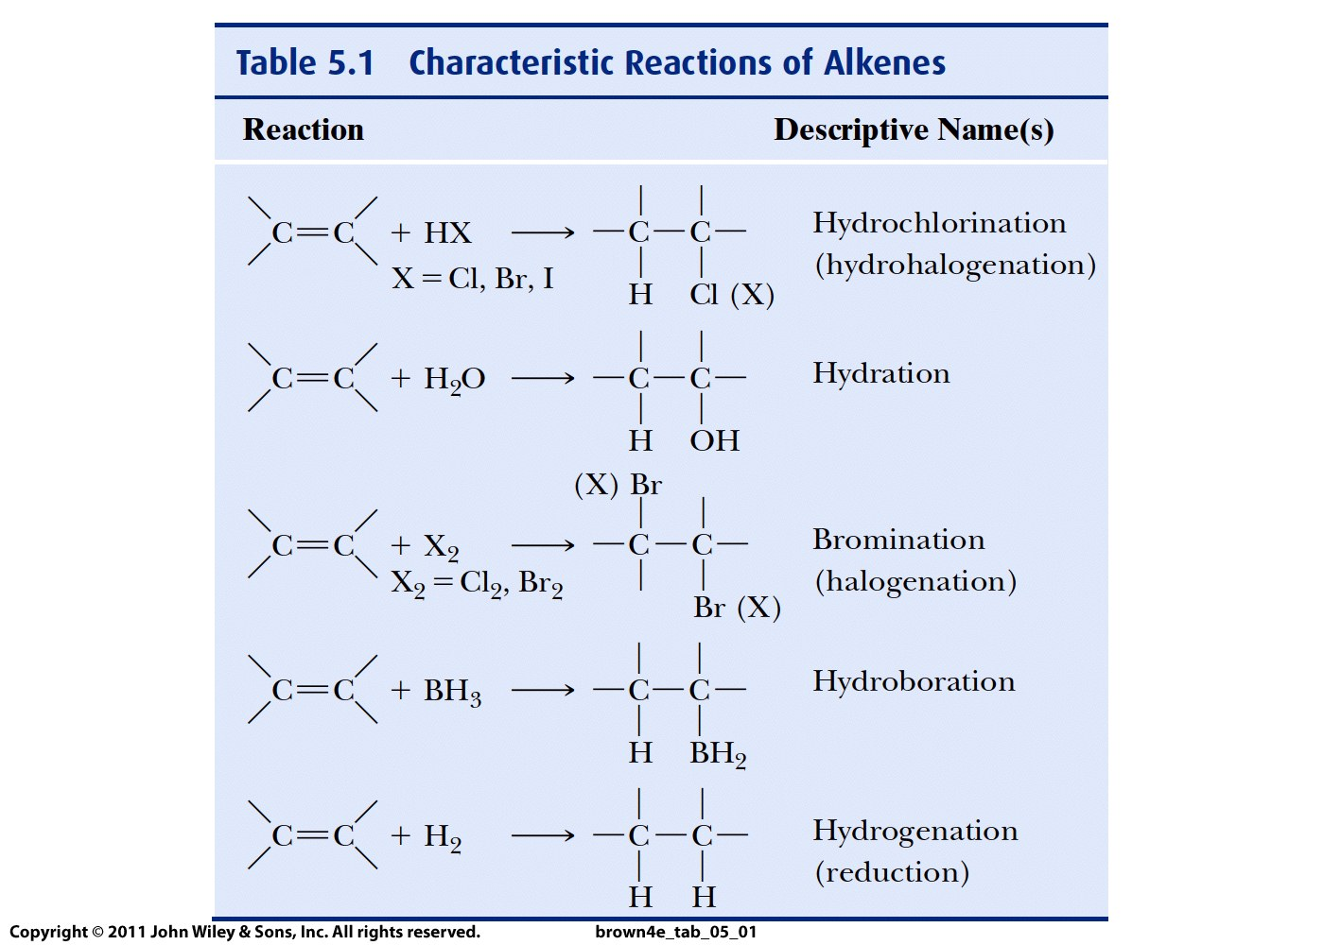
You need
to know
mechanisms
Also these
for alkyl
halides:
S_{N}1
S_{N}2

Slide 2
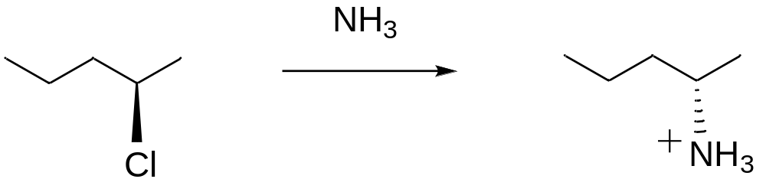
QUIZ
Show the mechanism of this reaction:

Slide 3
Lecture 21:
Reactions of haloalkanes:
Secondary alkyl halides

Slide 4
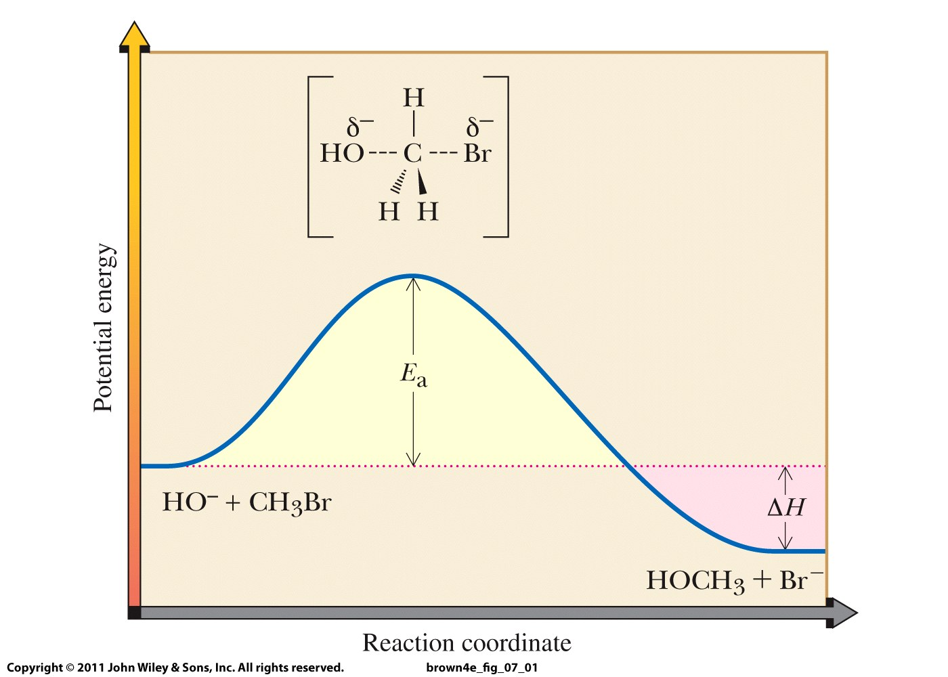

Slide 5
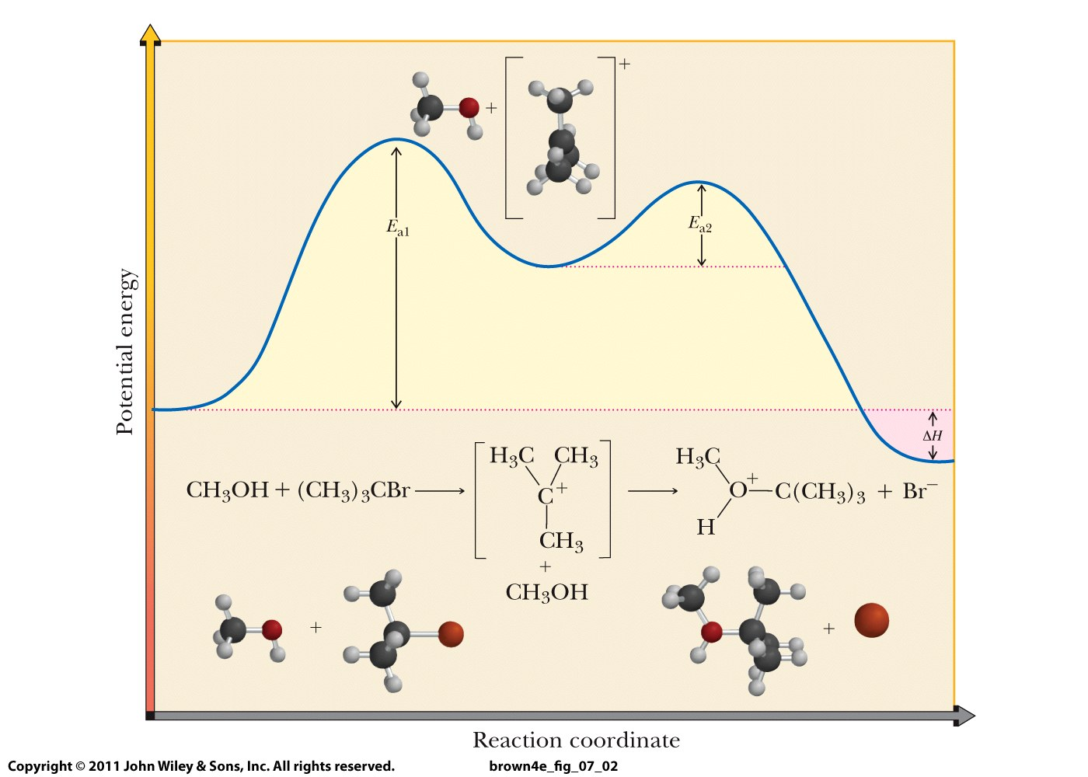

Slide 6
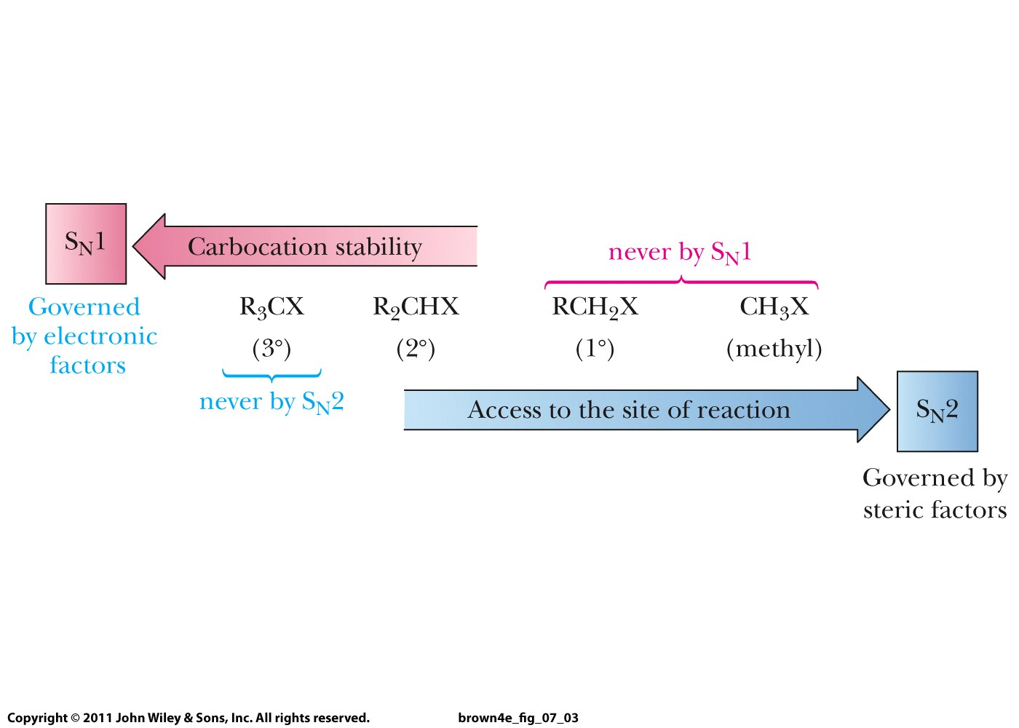

Slide 7
S_{N}1 and S_{N}2 mechanisms:
Tertiary alkyl halides: S_{N}1
Primary alkyl halides: S_{N}2
Secondary alkyl halides: S_{N}1 if poor nucleophile,
S_{N}2 if good or moderate nucleophile

Slide 8
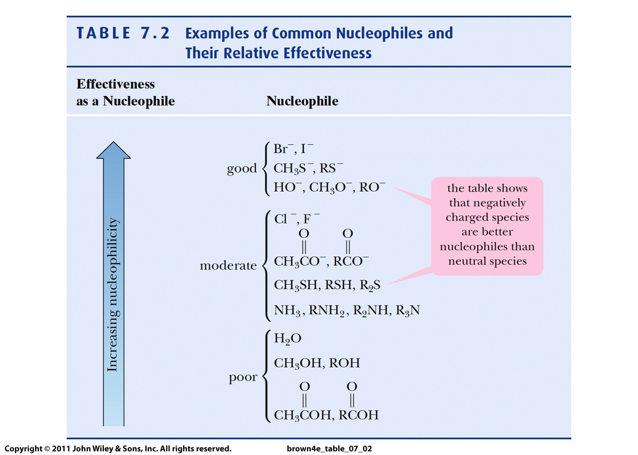

Slide 9
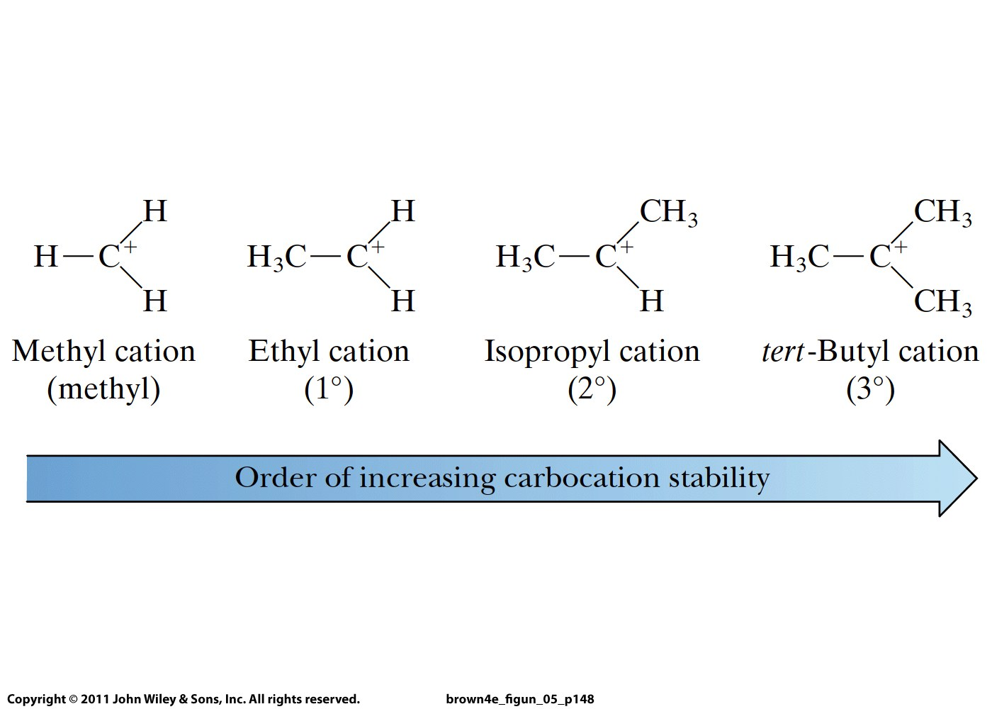

Slide 10
Nucleophilic substitutions of alkyl halides
Primary alkyl halide: always S_{N}2 that leads to inversion of absolute configuration if the product has a chiral carbon at the substitution site
Tertiary alkyl halide: always S_{N}1 that leads to two stereoisomeric products if the product has a chiral carbon at the substitution site
Secondary alkyl halide: S_{N}2 if a good or moderate nucleophile, S_{N}1 if a poor nucleophile
Strong nucleophiles: negatively charged molecules and ammonia and amines; weak: the rest
If S_{N}1, remember to check for carbocation rearrangement
If your alkyl halide does not contain a chiral center, you can ignore stereoisomeric products
Fluorine cannot be substituted

Slide 11
